Slide 1
Service Oriented Architecture in Cloud Computing
Prepared by
Er.Harendra Bikram Shah
(Lecturer)
Department of Computer Engineering

Slide 2
OUTLIINES
Existing Cloud Application: Processing Pipelines, Batch Processing Systems in Cloud Web Applications
Architecture Style for Cloud Applications,
Workflow in Cloud Applications,
Hadoop System,
Hadoop Distributed File System,
Task Programming and MapReduce Programming,
Service Oriented Architecture (SOA),
Characteristic of SOA.

Slide 3
Processing Pipelines, Batch Processing Systems in Cloud Web Applications
Data must be processed before it is consumed.
By definition, a data pipeline represents the flow of data between two or more systems.
It is a set of instructions that determine how and when to move data between these systems.
There are many data processing pipelines. One may:
“Integrate” data from multiple sources
Perform data quality checks or standardize data
Apply data security-related transformations, which include masking, anonymizing, or encryption
Match, merge, master, and do entity resolution
Share data with partners and customers in the required format
Consumers or “targets” of data pipelines may include:
Data warehouses like Redshift, Snowflake, SQL data warehouses, or Teradata
Reporting tools like Tableau or Power BI
Another application in the case of application integration or application migration
Data lakes on Amazon S3, Microsoft ADLS, or Hadoop – typically for further exploration
Artificial intelligence algorithms
Temporary repositories or publish/subscribe queues like Kafka for consumption by a downstream data pipeline

Slide 4
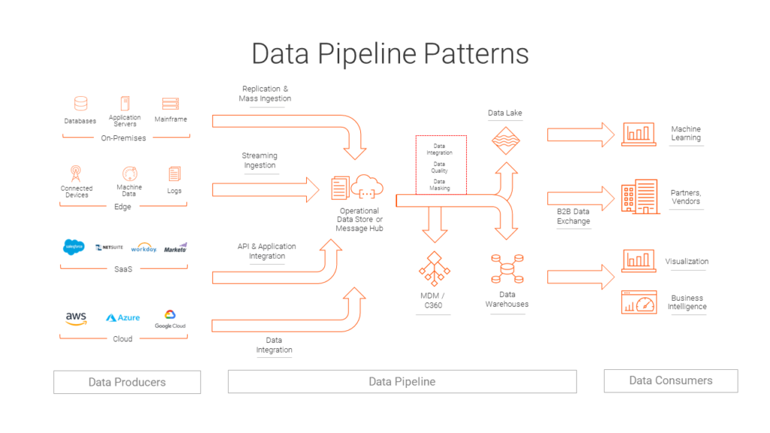

Slide 5
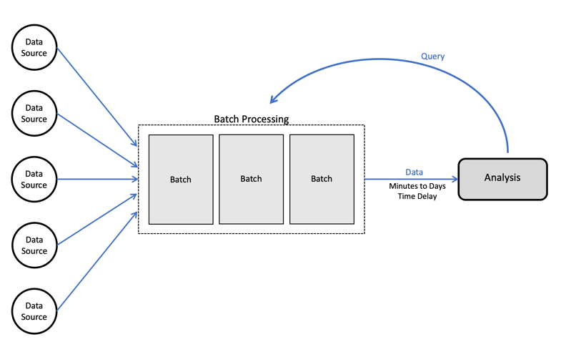
Batch processing is a method of running high-volume, repetitive data jobs.
The batch method allows users to process data when computing resources are available, and with little or no user interaction.
Batch processing plays a critical role in helping companies and organizations manage large amounts of data efficiently.
It is especially suited for handling frequent, repetitive tasks such as accounting processes.
In every industry and for every job, the basics of batch processing remain the same.
The essential parameters include:
who is submitting the job
which program will run
the location of the input and outputs
when the job should be run.

Slide 6
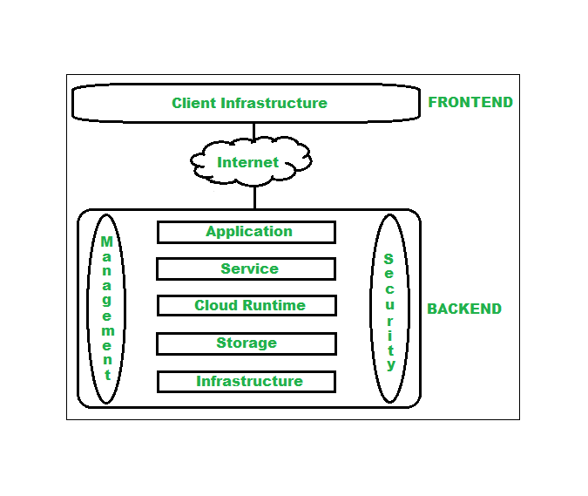
Cloud Computing Architecture Architecture of cloud computing is the combination of both SOA (Service Oriented Architecture) and EDA (Event Driven Architecture).
Frontend
Backend

Slide 7
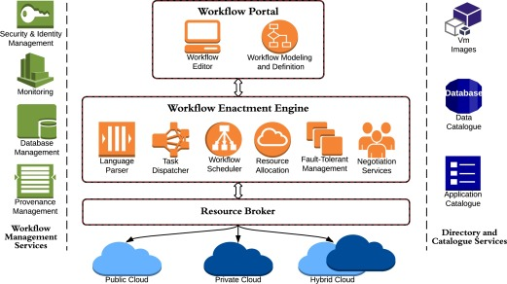
Workflow in Cloud Applications

Slide 8
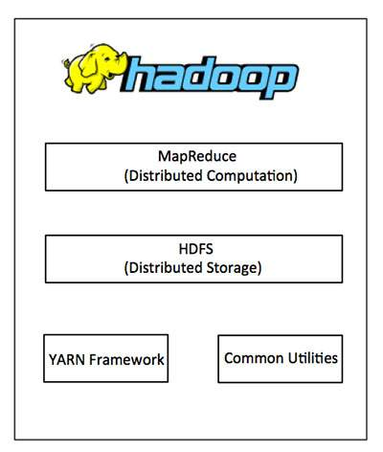
Hadoop and HDFS
Hadoop is an open-source framework that allows to store and process big data in a distributed environment across clusters of computers using simple programming models.
It is designed to scale up from single servers to thousands of machines, each offering local computation and storage.
Hadoop Architecture
At its core, Hadoop has two major layers namely −
Processing/Computation layer (MapReduce)
Storage layer (Hadoop Distributed File System).
MapReduce is a framework using which we can write applications to process huge amounts of data, in parallel, on large clusters of commodity hardware in a reliable manner.
Hadoop Common − These are Java libraries and utilities required by other Hadoop modules.
Hadoop YARN − This is a framework for job scheduling and cluster resource management.
HDFS is a distributed file system that handles large data sets running on commodity hardware

Slide 9
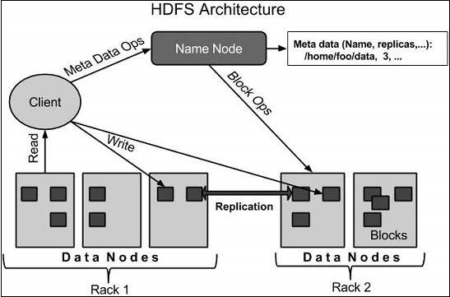
HDFS
HDFS holds very large amount of data and provides easier access.
To store such huge data, the files are stored across multiple machines.
These files are stored in redundant fashion to rescue the system from possible data losses in case of failure.
HDFS also makes applications available to parallel processing.

Slide 10
Goals of HDFS
Fault detection and recovery
Huge datasets .
Hardware at data

Slide 11
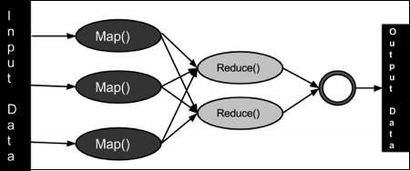
MapReduce
MapReduce is a framework using which we can write applications to process huge amounts of data, in parallel, on huge cluster on local hardware
Map stage (Splitting and Mapping)−.Takes data and convert into new data set
Reduce stage(Shuffling and Reducing ) −.Takes data from Map stage and produce Output.
Architecture

Slide 12
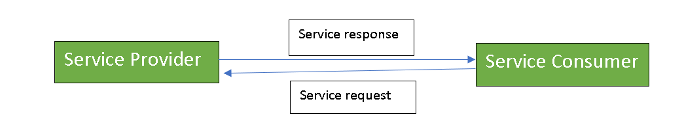
Service Oriented Architecture
A Service-Oriented Architecture or SOA is a design pattern which is designed to build distributed systems that deliver services to other applications through the protocol.
They are the architectural approach in which applications make use of services available in the network.
The first report published on SOA by the analysts Roy W.Schulte and Yefim V.Natis in 1996.
There are two major roles within Service-oriented Architecture:

Slide 13
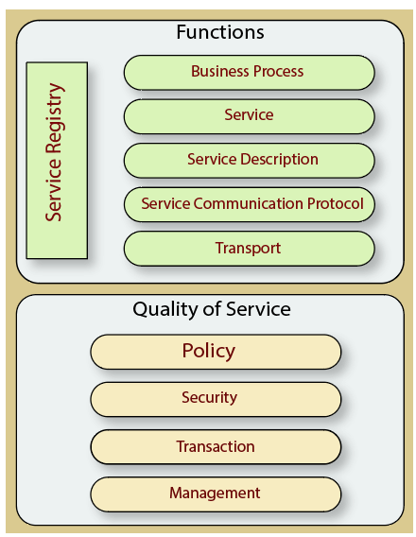
Components of SOA:

Slide 14
Guiding Principles of SOA:
Characteristics of SOA:
Standardized Service Contract
Loose Coupling
Service Abstraction
Service Reusability
Service Autonomy
Service Discoverability
Service Composability
SOA supports loose coupling everywhere in the project.
SOA supports interoperability.
SOA increases the quality of service
SOA supports vendor diversity.
SOA promotes discovery and federation.
SOA is location-transparent
SOA is still maturing and achievable idea

Slide 15
Advantages of SOA:
Service reusability:
Easy maintenance: .
Platform independent:
Availability:
Reliability:
Scalability:
Disadvantages of SOA:
High overhead: .
High investment:
Complex service management:
Practical usage of SOA:
Military
Health Sector
Gaming's

Slide 16
End of the UNIT 6

